Slide 1
CG501-Course Project Implementation of a MLP on FPGA using Verilog
Romit Mohane
23110279 B.Tech. in AI, Class of 2023

Slide 2
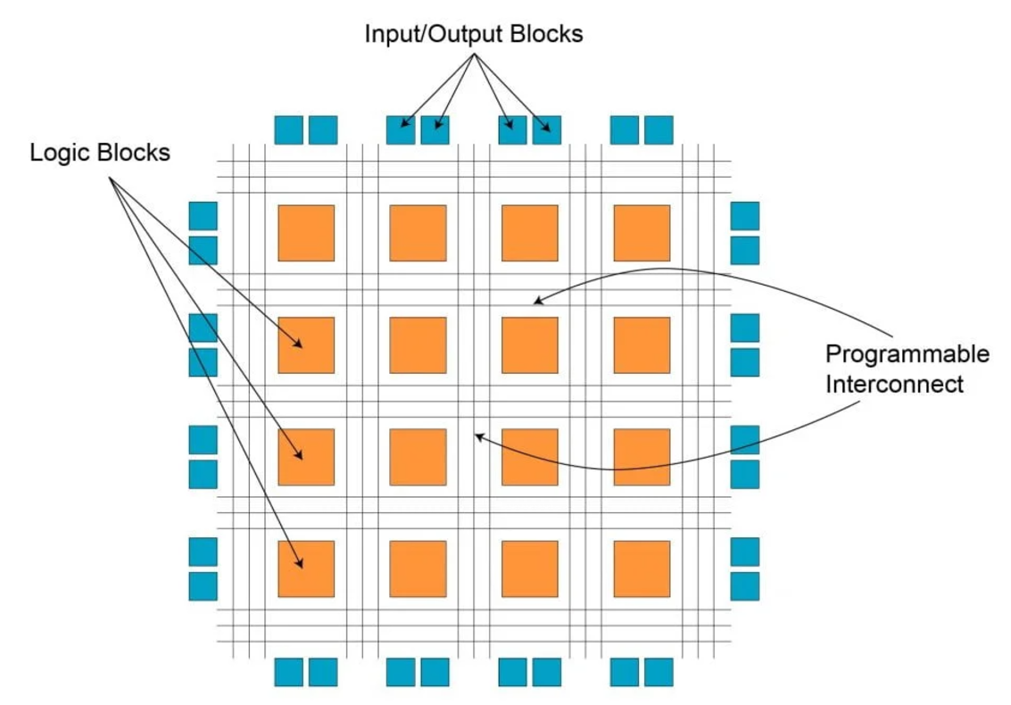
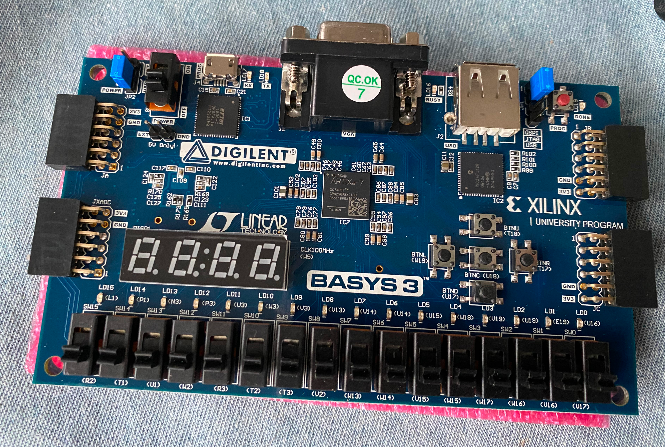
Learning Outcomes
To understand the working of FPGA (Field-Programmable Gate Array) boards.
Implementing hardware circuits using a HDL (Hardware description language) such as Verilog.
To develop a low-level understanding of Neural Networks (specifically MLP) and understand the limitations involved in running them on low-power or low-memory devices.
Learn to simulate the implemented circuits and test them using Xilinx Vivado, which enables my future self to work on low-level projects related to AI/ML.
FPGA Architecture
Source: FPGA Design, Architecture and Applications (Updated) [2024]
A FPGA board
Source: Introduction to FPGAs | Stephen Smith's Blog

Slide 3
Resources Used
I used various tutorial websites, YouTube videos and other web resources to learn everything necessary to build this project
Video - The best way to start learning Verilog
Verilog, Formal Verification and Verilator Beginner's Tutorial
FPGA Fundamentals: Basics of Field-Programmable Gate Arrays
Video - Vivado Simulator and Test Bench in Verilog | Xilinx FPGA Programming Tutorials
Video - How to use vivado for Beginners | Verilog code | Testbench | Schematic View
HDLBits — Verilog Practice
Neural Networks on FPGA: Part 2: Designing a Neuron

Slide 4
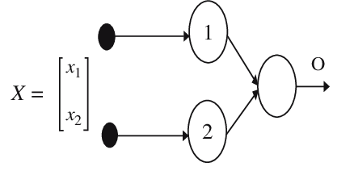

Main Idea of the Project
Main idea of the project was to implement a Single perceptron, as well as a MLP with 1 hidden layer using Verilog, which is a Hardware description language used to synthesize gate level circuits on FPGA boards.
Since I did not know Verilog or the design tools used to simulate the circuits, learning them and writing a working simulation was one of the main goals.
The project also focused on understanding the composition and working of a MLP, which is composed of 2 perceptrons in the hidden layer and 1 perceptron connected to them as the output. I tested the perceptron as well as the MLP by writing testbench code and simulated it using Vivado.
Architecture of the MLP
Vivado Design Suite is a software suite for synthesis and analysis of hardware description language (HDL)

Slide 5
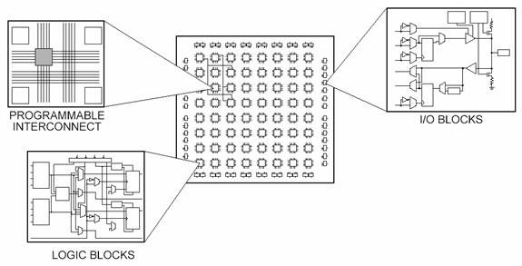
Background
Field-Programmable­ Gate Arrays (FPGAs) are reprogrammable and flexible logic devices which allows designers to make custom digital circuits using Hardware­ Description Languages (HDLs) like VHDL or Ve­rilog. The circuits are composed of the onboard I/O blocks, Logic blocks and Memory.
The implementation of TinyML models on low-power edge or IoT devices is a field of rapid progress and active research, and FPGA programming is a gateway into it. The benefits of running ML models on FPGA include:
Low latency
Reprogrammable
Integration with IoT devices like microcontrollers
The Different Parts of an FPGA
Source: FPGA Fundamentals: Basics of Field-Programmable Gate Arrays - NI

Slide 6
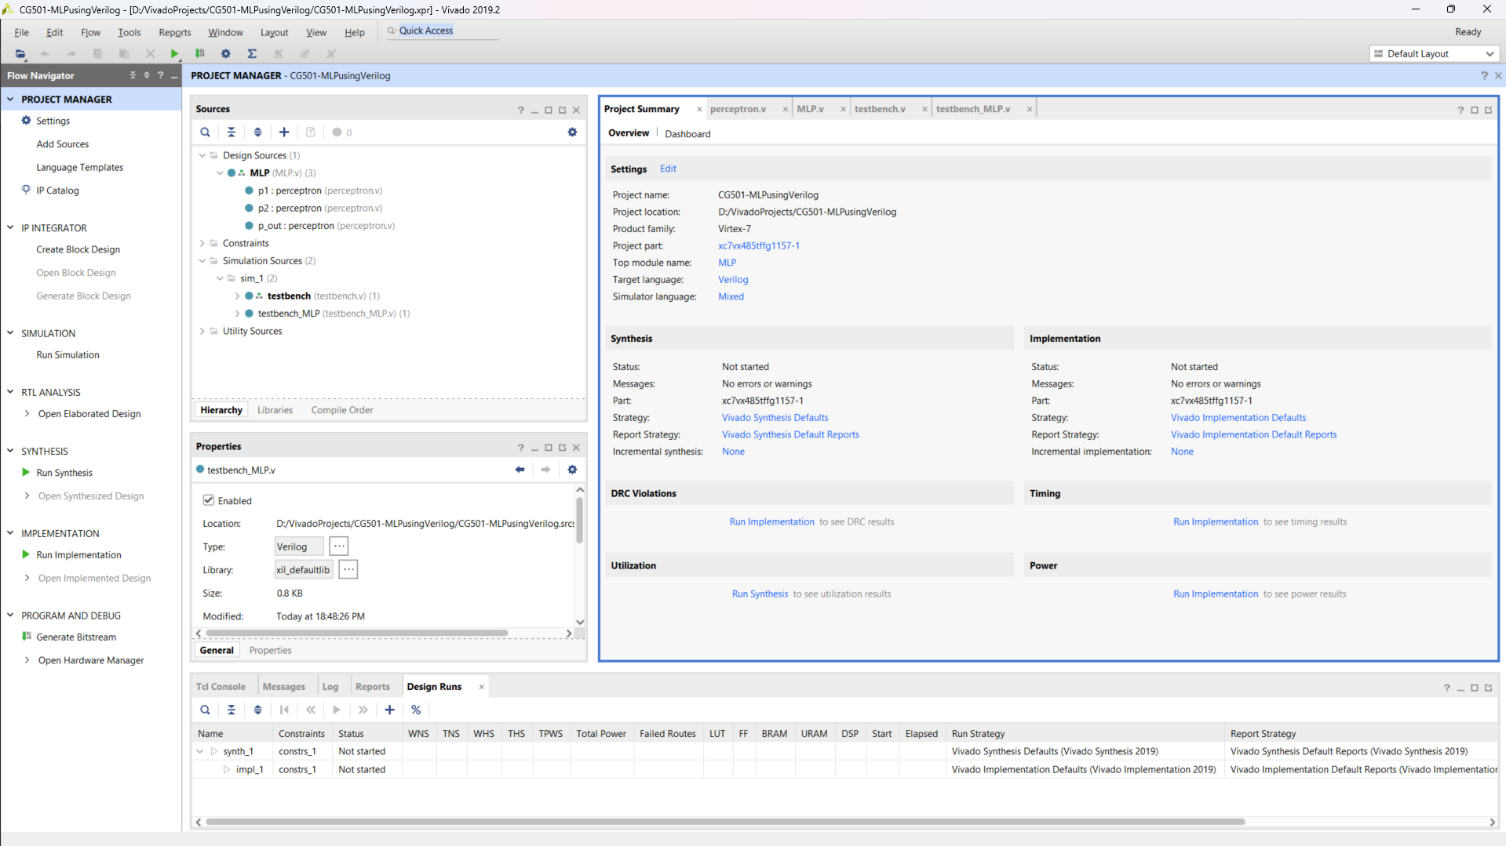
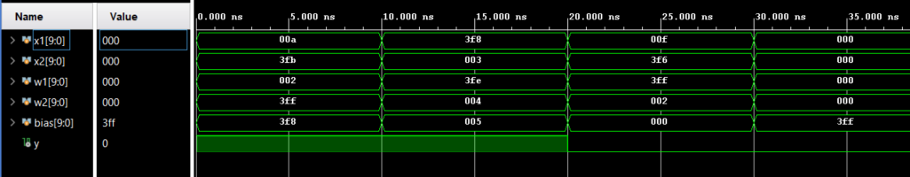
Implementation
First, we setup Xilinx Vivado, which is a software for synthesis and analysis of HDLs like Verilog. After installing and obtaining the licences for the same, we setup a project with 2 design sources, MLP.v and perceptron.v which contains the Verilog code for the synthesis of these circuits.
Simulation view of Xilinx Vivado, showing the waveforms of the signal passing through the different wires and registers at specific times.
Project view of Xilinx Vivado

Slide 7
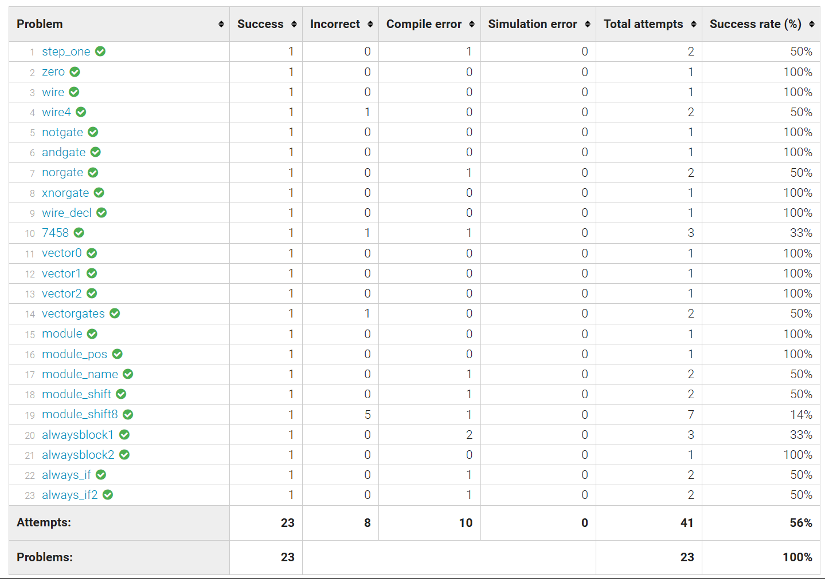
Implementation
Now, to learn Verilog, I utilised various videos and the website HDLBits which covered the various elements of Verilog and had various practice problems as well.
Stats of the practice problems I completed to learn Verilog

Slide 8
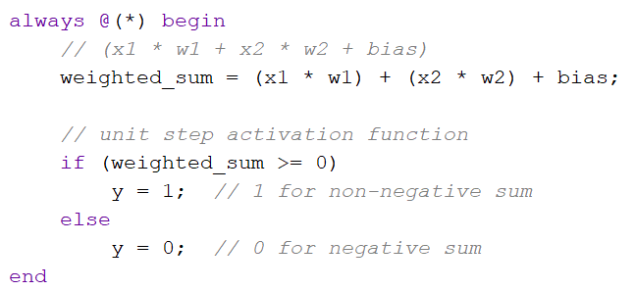
Implementation
Coming to the implementation of the perceptron’s code, we defined all the inputs and outputs of the perceptron.
The logic inside a perceptron is implemented using `always` block, which is one of the Procedures provided in Verilog. It allows for a richer set of statements and a similar syntax to programming languages such as C.
Part of the perceptron.v file

Slide 9
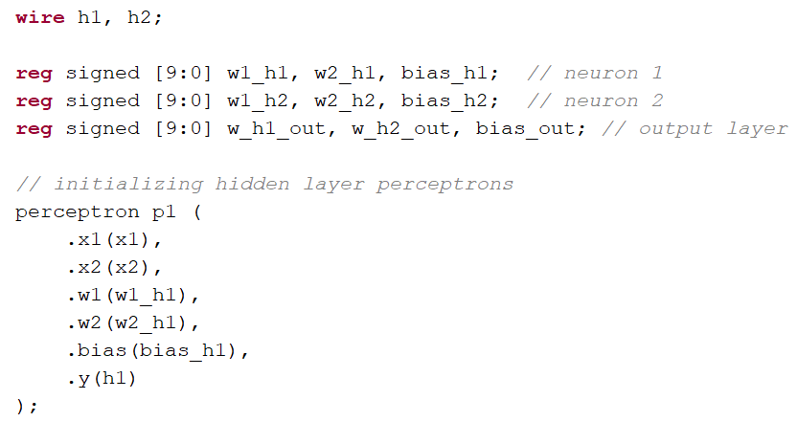
Implementation
The implementation of the MLP mainly consists of the initialization of the 3 perceptrons and connecting their inputs and outputs appropriately to form the desired MLP.
In Verilog, the connections are done through `wires` which are directional in nature and allow for information to flow from one source to one or more than one sinks.
Part of the MLP.v file

Slide 10
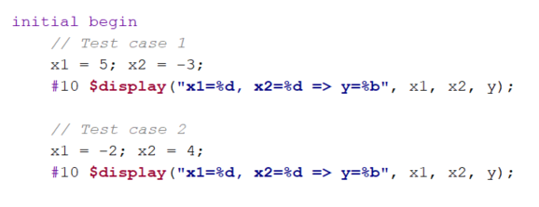
Implementation
Next, we write the testbench code for testing and simulating both the perceptron and the MLP as a whole.
In testbench code, we utilise the special keyword `$display` to log out the outputs from the MLP in addition to the simulated waveform.
Part of the testbench_MLP.v file

Slide 11
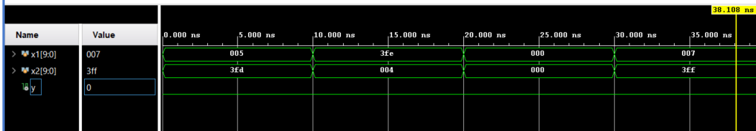
Results and Discussion
We get the simulated waveform for x1 and x2 as well as y values from the output of the MLP.
The MLP is limited by having just integer values as the weights and biases.
Simulation with the test cases in testbench_MLP.v file

Slide 12
Limitations
Verilog doesn’t support floating point numbers natively.
Implementation of complex networks manually is cumbersome, and can be helped by the use of HLS (High level synthesis) tools.
The waveform outputs doesn’t provide the waveforms of the intermediated inputs and outputs.

Slide 13
Bibliography
HDLBits — Verilog Practice
Neural Networks on FPGA: Part 2: Designing a Neuron
FPGA Design, Architecture and Applications
No help obtained from others, only through YouTube and websites.
No use of AI tools like Chat-GPT
Amount of time invested – approximately 12 hours

